Slide 1


THINK OUT OF THE BANK
Kube₹
TEAM NAME

Slide 2

INVESTMENT IMBALANCE
1 million potential investors. 12 million potential borrowers.
Trillions of USD at investors' disposal being idle, due to the lack of investment opportunities.
GEOGRAPHICAL IMBALANCE
Low deposit rates in developed countries.
In developing countries the loan interest rates are very high.
Entrepreneurs cannot get loans even if they accept the conditions.
Premises

Slide 3

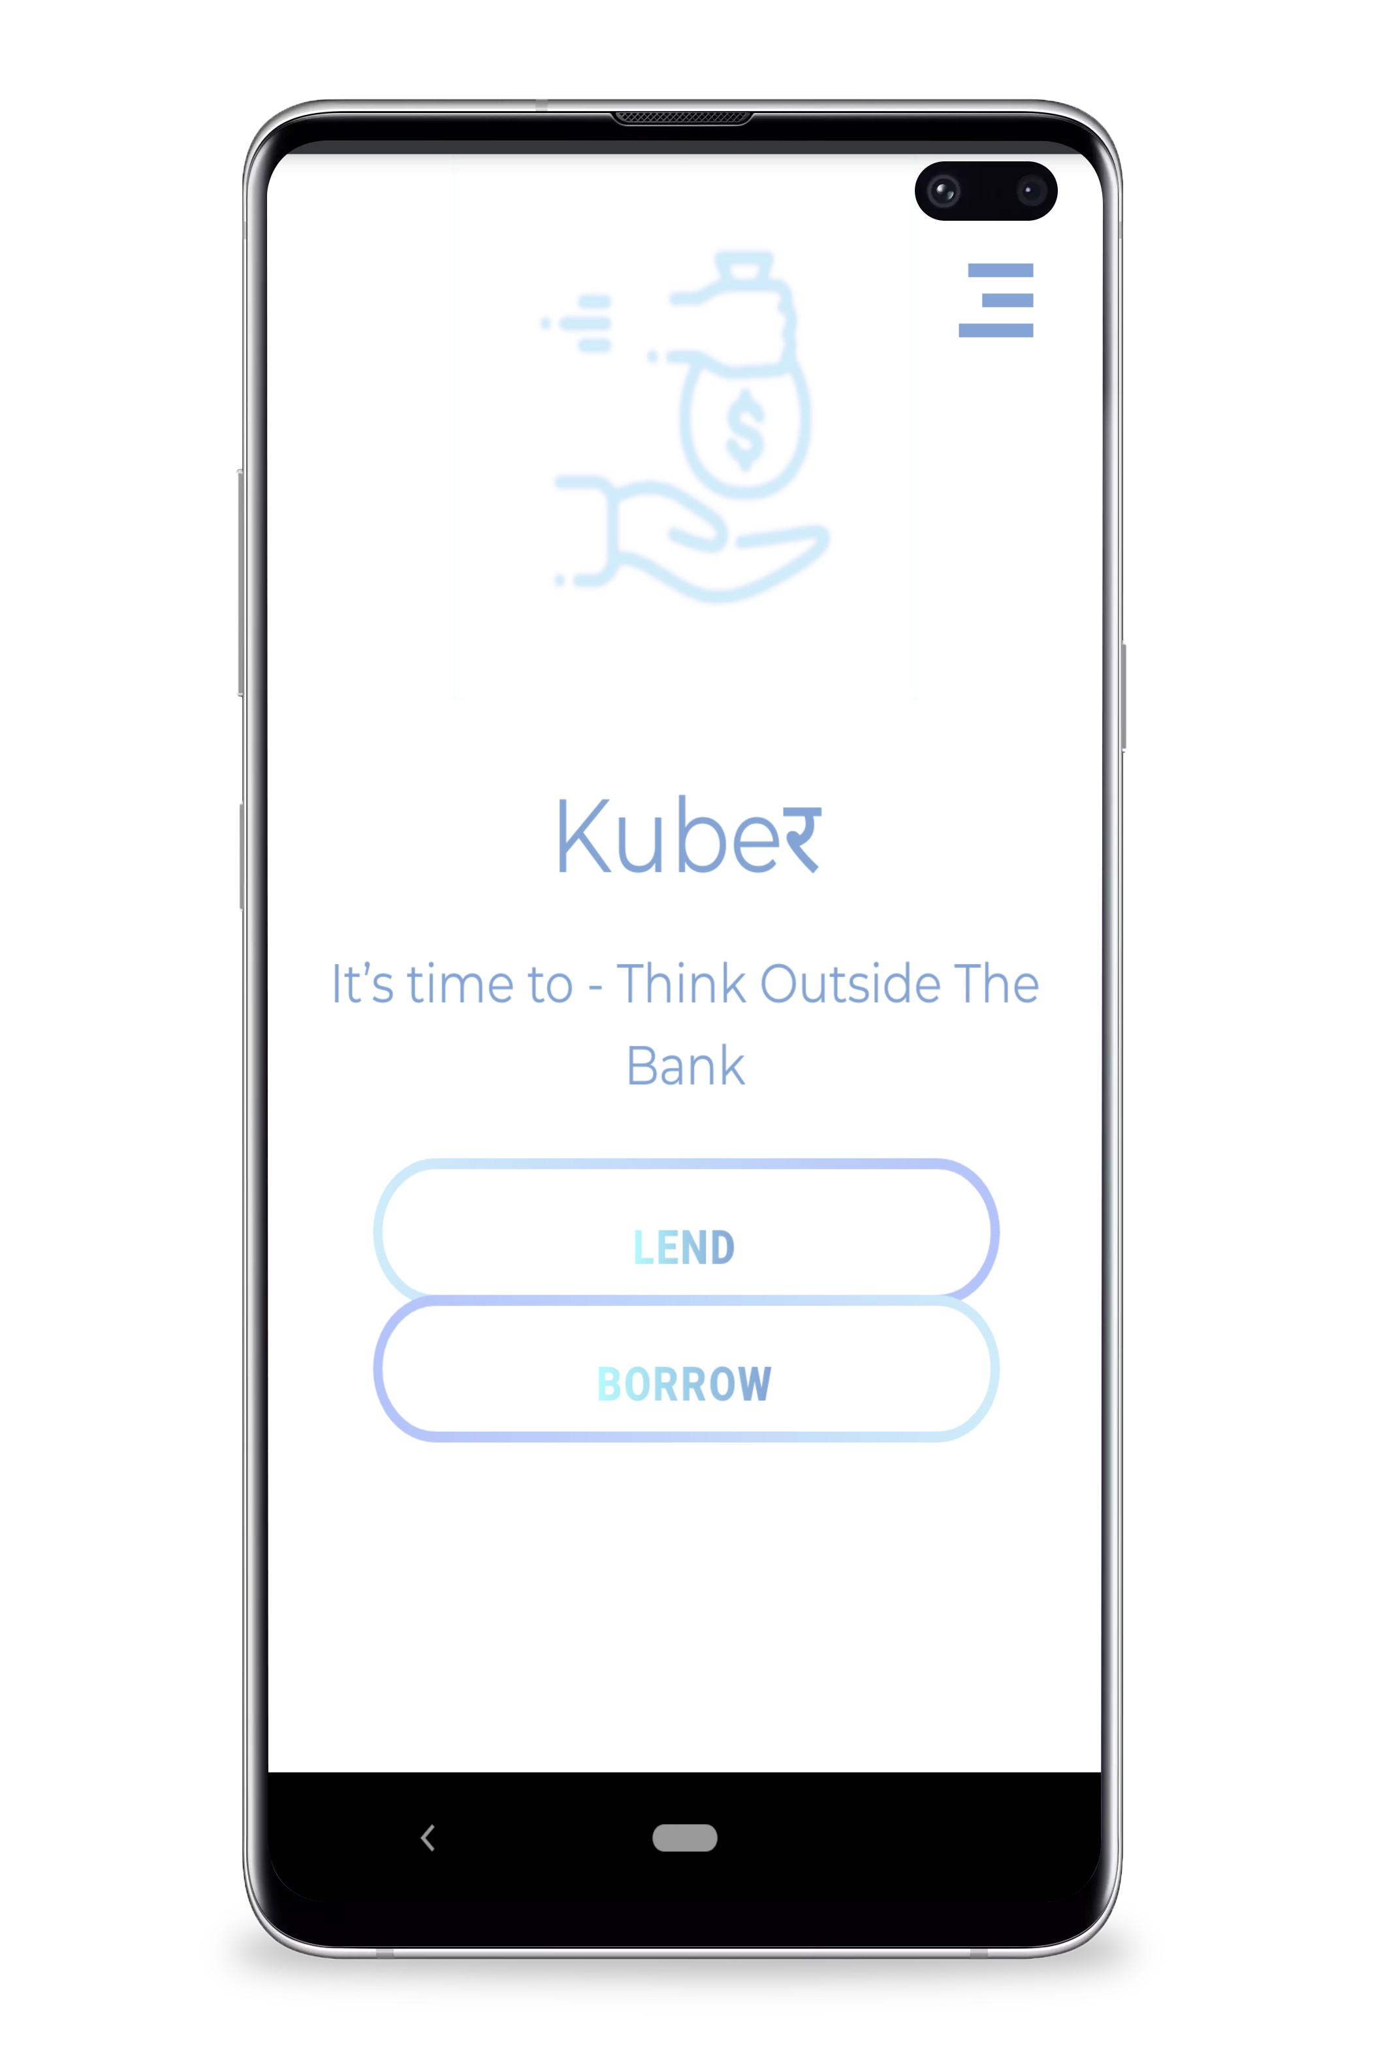

Kube₹
CROSS-BORDER PEER-TO-PEER PLATFORM USING BLOCKCHAIN TECHNOLOGY THAT ENABLES INVESTORS TO DIRECTLY PROVIDE LOANS TO SMES (SMALL AND MEDIUM ENTREPRENEURS) AND OTHER POTENTIAL BORROWERS

Slide 4
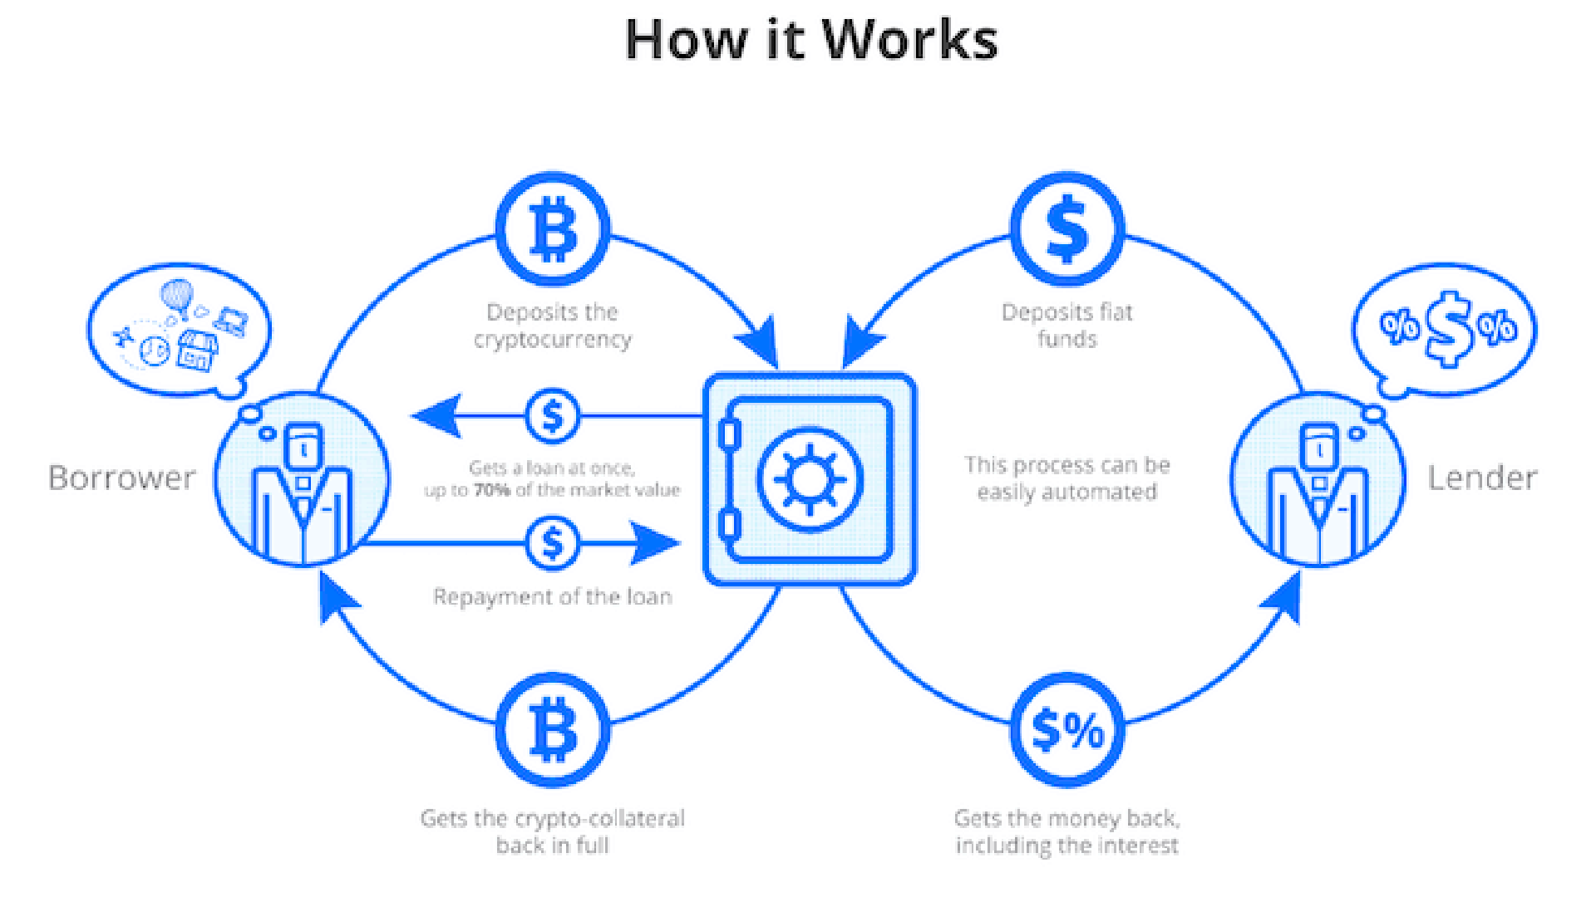

Slide 5

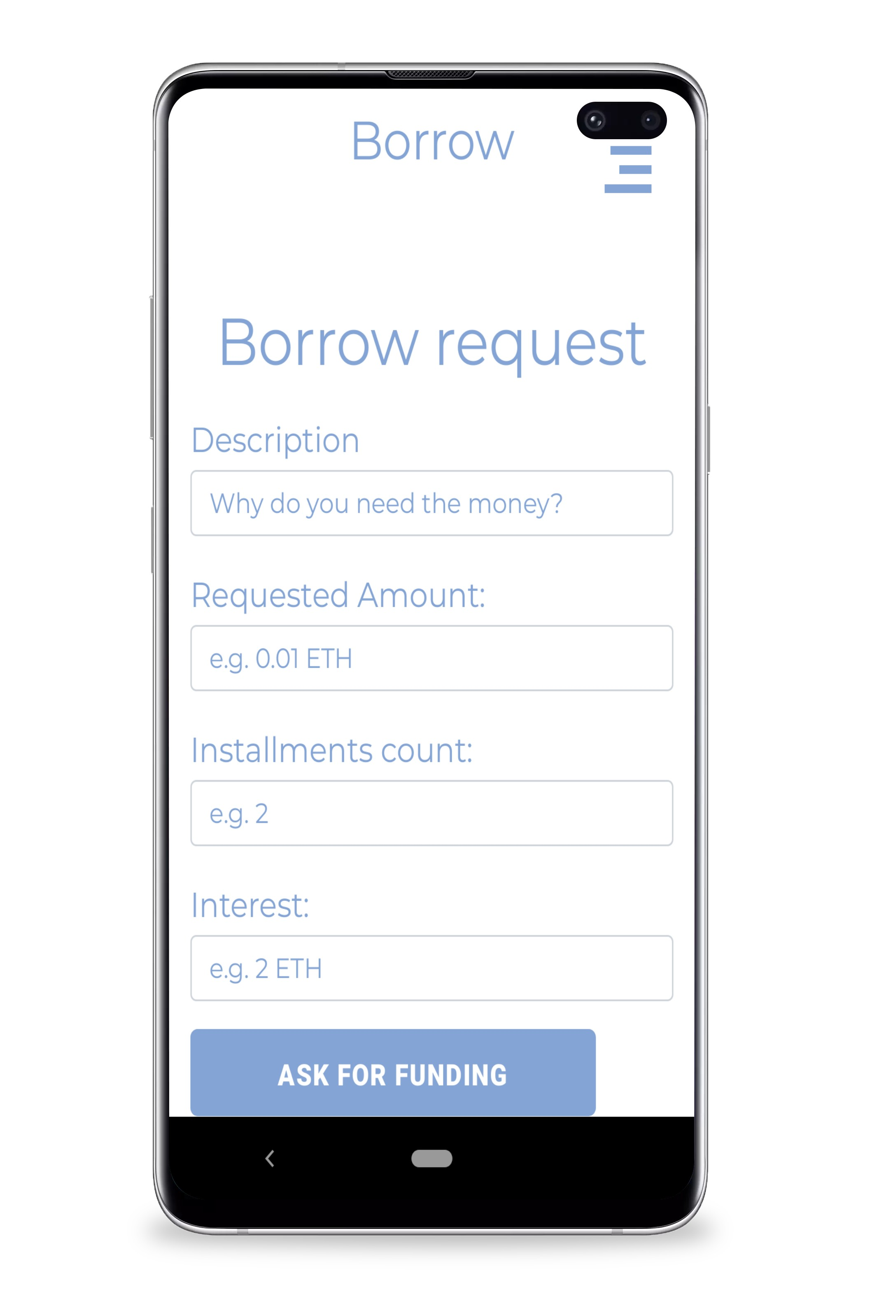
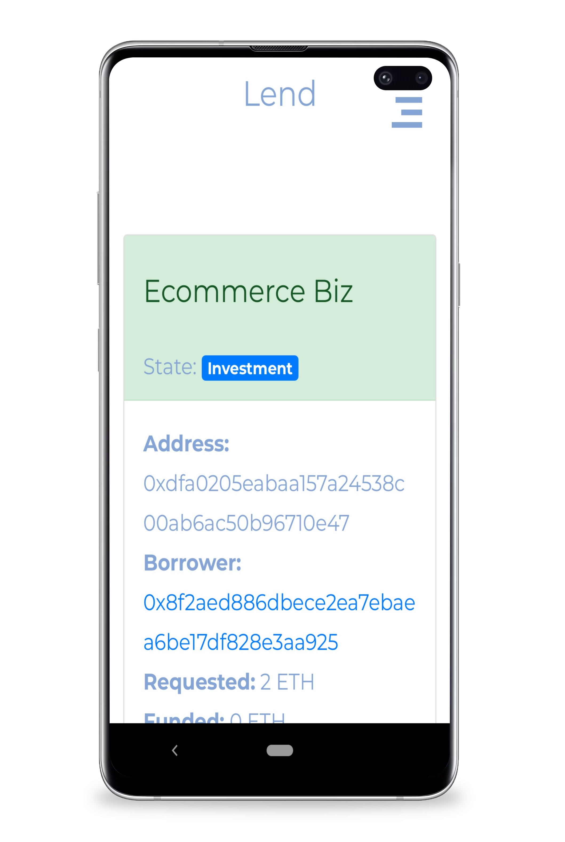
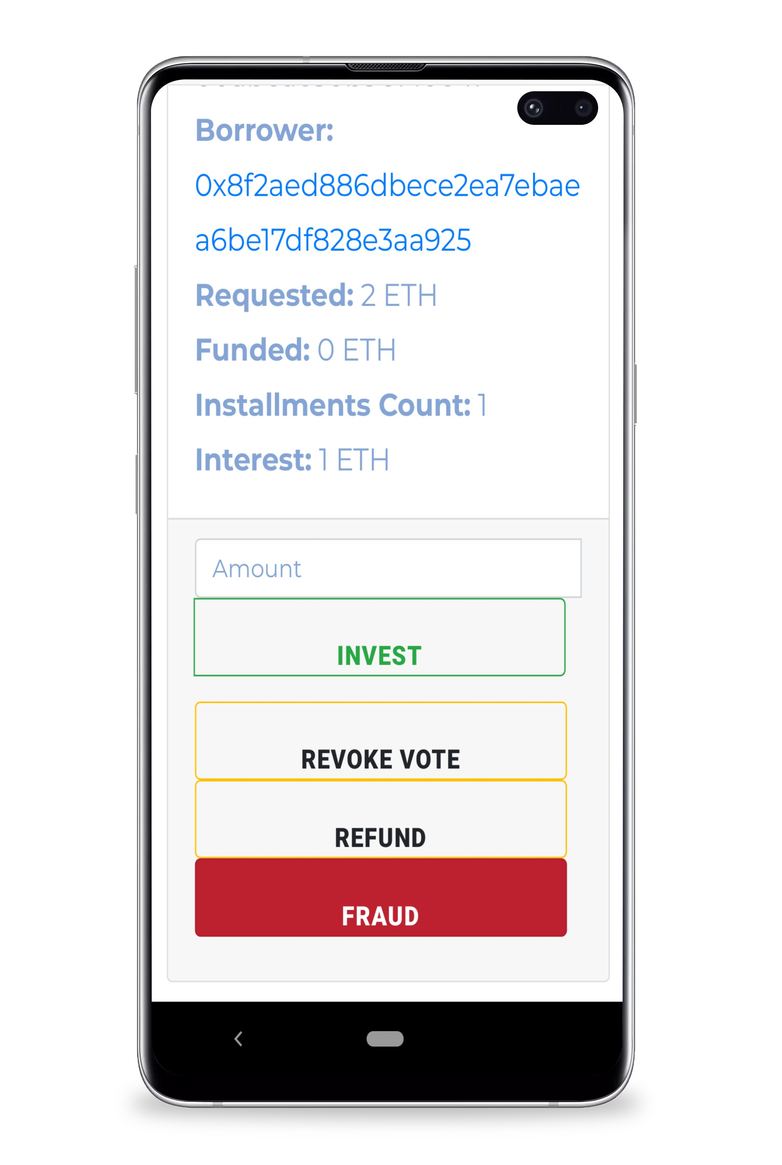

Slide 6
HIGH-TECH
Smart scoring to reduce default risk. Document e-management using digital signature
Kube₹ Features
PROFITABLE
No intermediaries - it means the higher income for an investor and lower interest rates for a borrower.
SAFE & CONVENIENT
Secure and simple interfaces, personal account, mobile application and e-document management

Slide 7

BANKS
KUBE₹
Seconds to approve a SME loan
Months to approve an SME loan
Banks prefer providing secured credits, according to regulations
It is very risky for SMEs to receive funds from a single bank or investor.
Best case scenario is that investors' income from deposits covers inflation
Works with both secured and unsecured loans
Crowdlending (funding from a few private investors) is used
Helps investors and borrowers to contract in mutually beneficial terms

Slide 8
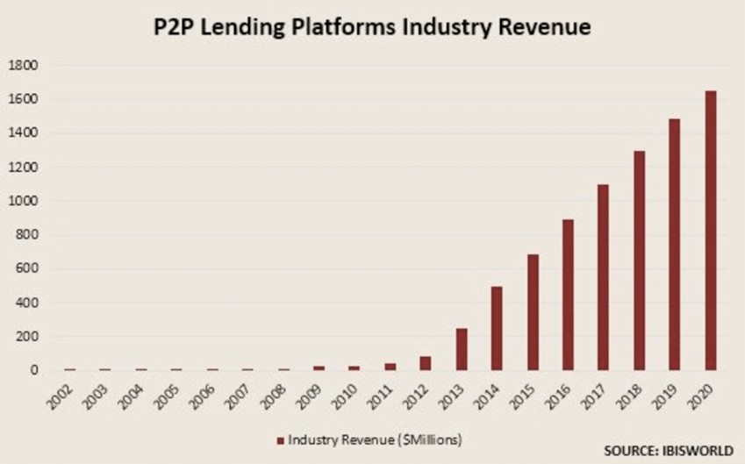

Growth

Slide 9
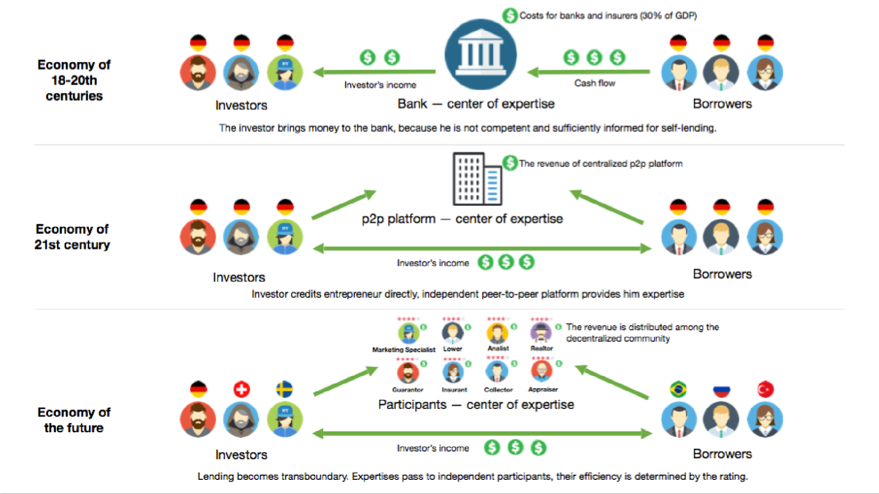

Slide 10

PAYBACK IN CASE OF DEFAULT IN ANOTHER COUNTRY
Insurance option to sell the loan to the guarantor in case of default for the borrower.
EXCHANGE RATE RISK
No convenient mechanism for insurance exchange rate risk for small amounts of investments
We will create our own fund for currency risk insurance, which will further reinsure risk in international banks
What Sets Us Apart?

Slide 11


Using Blockchain
TRANSPARENCY AND INFINITY.
The user will encounter a fiat only when raising and withdrawing funds on the platform.
TECHNICAL
CHARACTERISTICS
The platform uses the sdBFT consensus algorithm - an improved version of the dBFT algorithm
SYNC
Sync the schedule of payments in order to obtain info about the upcoming payments of the borrower
OPEN
SOURCE
Logic of the smart contracts is visible to all people.

Slide 12

REPUTATION (KARMA)
Good Karma of each member increases the demand for his services or improves his loan conditions
SMART SCORING
Financial condition assessment Work experience and education
Order Rating System
COLLATERAL
Real-estate, vehicles and equipment
Option for collateral selling in case of default

Slide 13

Thank You!

